Slide 1
( Computer Graphics)
Lecture 6
Ellipse - Generating Algorithms

Slide 2
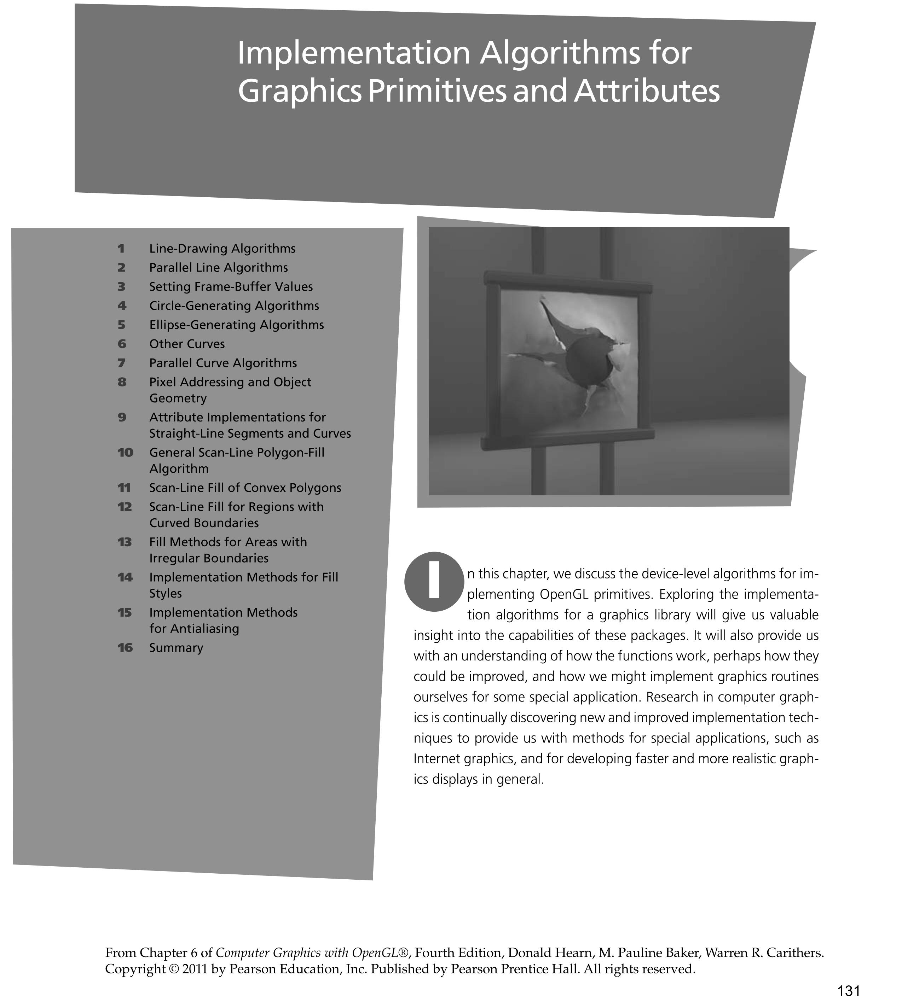

Slide 3
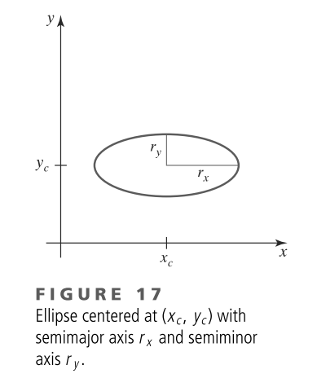
Ellipse-Generating Algorithms

Slide 4
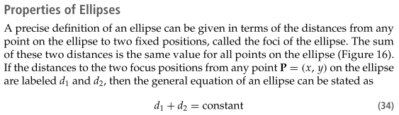
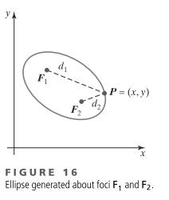
Ellipse-Generating Algorithms

Slide 5
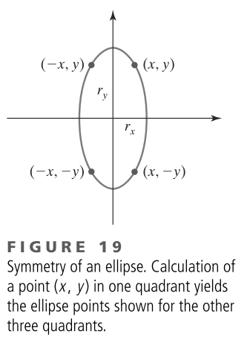
Midpoint Ellipse Algorithm

Slide 6
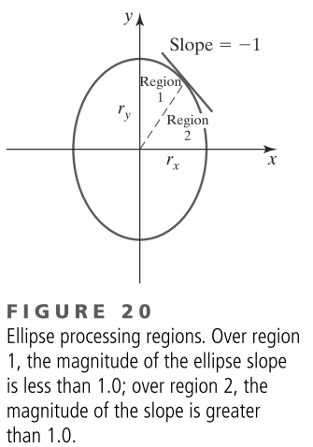
Midpoint Ellipse Algorithm

Slide 7
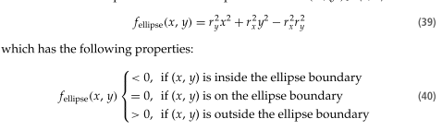
Midpoint Ellipse Algorithm

Slide 8
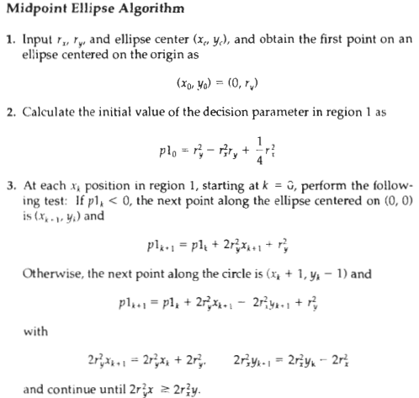

Slide 9
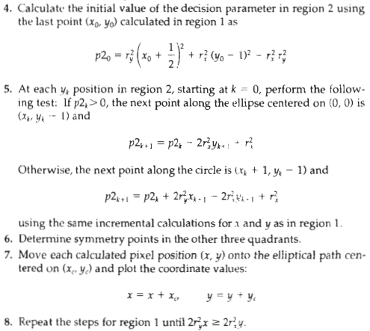

Slide 10
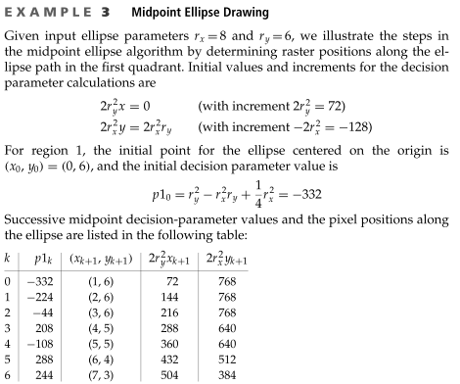
Midpoint Ellipse Algorithm

Slide 11
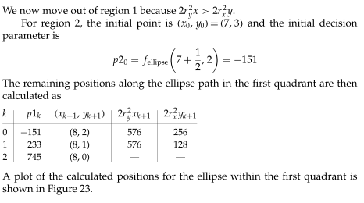
Midpoint Ellipse Algorithm

Slide 12
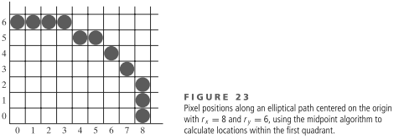
Midpoint Ellipse Algorithm

